Slide 1
PERFORMING ARTS
DANCE

Slide 2
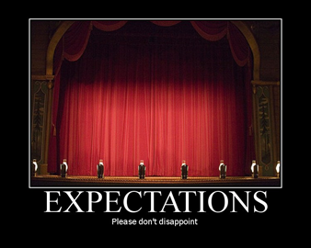

EXPECTATIONS
BE RESPECTFUL OF OTHERS IN THE CLASS.
TRY YOUR HARDEST AT ALL TIMES.
LISTEN TO FEEDBACK AND USE THIS CONSTRUCTIVELY TO IMPROVE YOUR PERFORMANCE.
LISTEN TO THE TEACHER AT ALL TIMES.
BE ABLE TO WORK AS A GROUP AND INDEPENDENTLY.
BE CREATIVE.
USE THE STAGE EFFECTIVELY.
LISTEN TO YOUR PEERS IDEAS

Slide 3
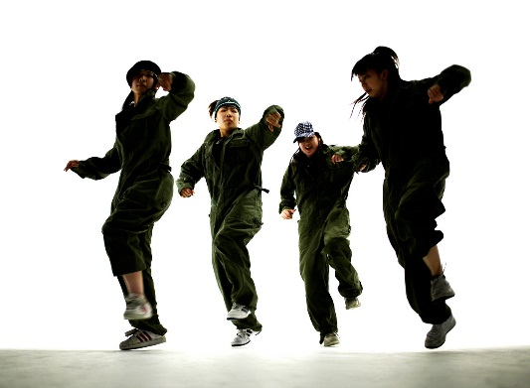
Learning Objective
To be able to:
Rehearse effectively working on targets given.
Perform the street dance routine focusing on timing, pace and technique

Slide 4
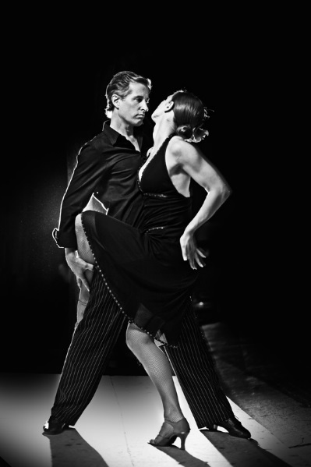
Success Criteria
Step 3
Can focus in the warm and identify some pulse raisers.
Can reproduce the taught routine with a few errors.
Step 4
Will focus and put effort in throughout the lessons and be able to identify the 3 sections of the warm up.
Will perform the routine with energy and focus.
Step 5.
Will concentrate and perform to the best of their ability throughout the lesson and work hard to warm up effectively.
Will perform with focus and accuracy of movement and always be keen to improve.
Step 6
Will be a role model to the group, work hard at all times and be proactive in asking and answering questions.
Will take a leadership role when rehearsing and help others to perform the routine.

Slide 5
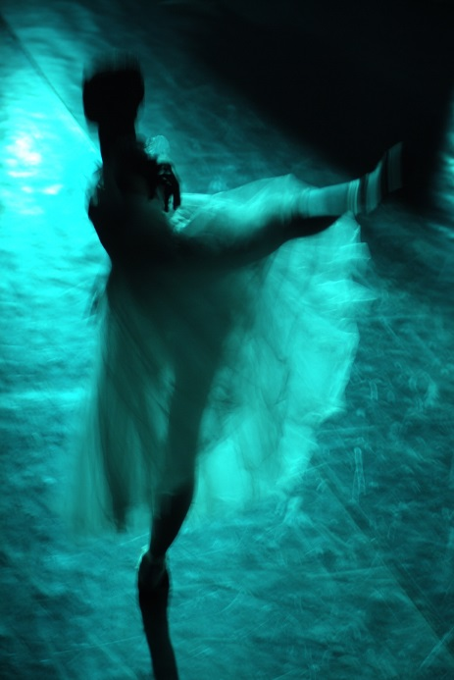
WARM UP yourselves up.
Recap own warm ups in groups
FOCUS on TEAM WORK
Should contain:
LEVEL 3=3 pulse raisers,
LEVEL 4= 3 Pulse raisers and 2 co-ordination exercises a
LEVEL 5= 3 pulse raisers, 2 co-ordination exercises nd 3 stretches.

Slide 6
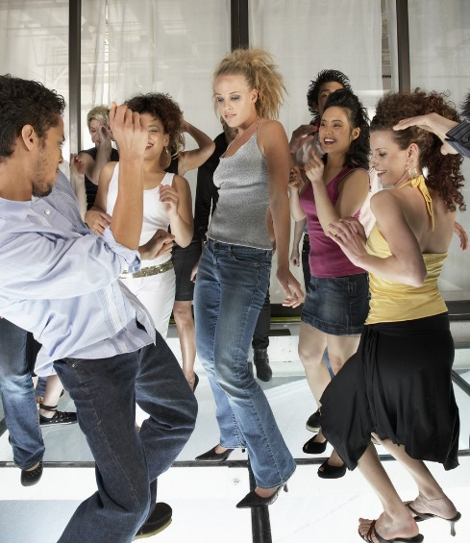
KEY WORDS
ACTION-WHAT
DYNAMIC-HOW
SPACE-WHERE
RELATIONSHIPS-WHO
RHYTHM-TIMING
FOCUS
ISOLATION
TECHNIQUE
Performance skills – what are these?

Slide 7
STREET DANCE
In the routine you now need to focus on your performance of movements!
You will perform to the class and receive feedback

Slide 8

PERFORMANCE!
In 2 groups you will now perform the routine to each other.
You need to think about;
Focus
Timing
Dynamics
DO NOT GIGGLE
IF IT GOES WRONG CARRY ON ANYWAY

Slide 9
PLENARY
How do you think you have performed?
What grade do you think you achieved?
Why?

